Slide 1

James Earl
Chair, Fortune Green & West Hampstead Neighbourhood Development Forum

Slide 2
The NDF was established in January 2012
The Forum & Area were designated by the London Borough of Camden in May 2013
The Forum published the proposed final draft of the Neighbourhood Plan in January 2014

Slide 3
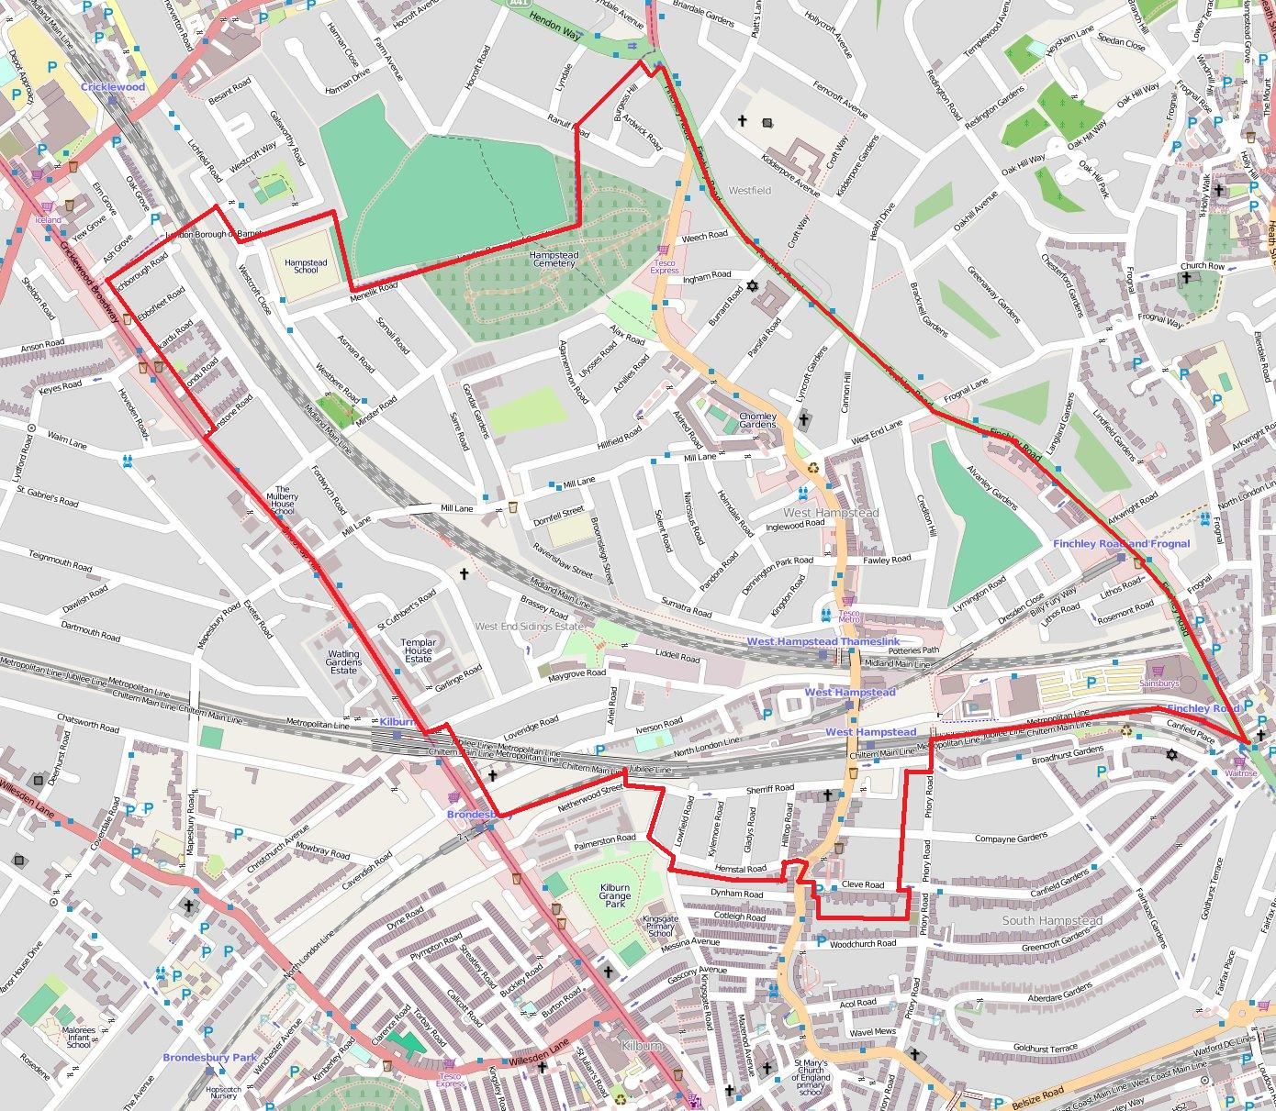

Slide 4
2011 Census
(Fortune Green & West Hampstead)
Population: 24,000
Households: 11,000
71% housing is flats or apartments
36% owner occupied
44% private rented
20% social rented
Area covered: 189 hectares

Slide 5
The Planning Context
The National Planning Policy Framework (for England)
The London Plan
Camden Council LDF & Core Strategy
Also:
Camden SPG
West Hampstead Place Plan

Slide 6
What have we done?
20 NDF meetings
4 Workshops
At least 6 Farmers’ market stalls
2 Jester Festival stalls
Christmas market
Leaflet to every household in the area

Slide 7
How have we engaged & consulted?
Mailing list: around 300 people
Twitter: more than 700 followers
West Hampstead Life blog
Leaflets, surveys, meetings, Area Action Forums, Residents groups meetings, meetings with developers, local press coverage, churches, schools etc…

Slide 8
London Plan: West Hampstead Growth Area
Map 2.4
10 “Areas for Intensification”
“West Hampstead Interchange” is one of them

Slide 9
London Plan: WH Growth Area
Annex One
West Hampstead Interchange:
“A significant inner London transport interchange with potential to improve connections between rail, underground and bus and to secure an uplift in development capacity through intensification”
Indicative employment capacity: 100
Minimum new homes: 800
2010-2031

Slide 10
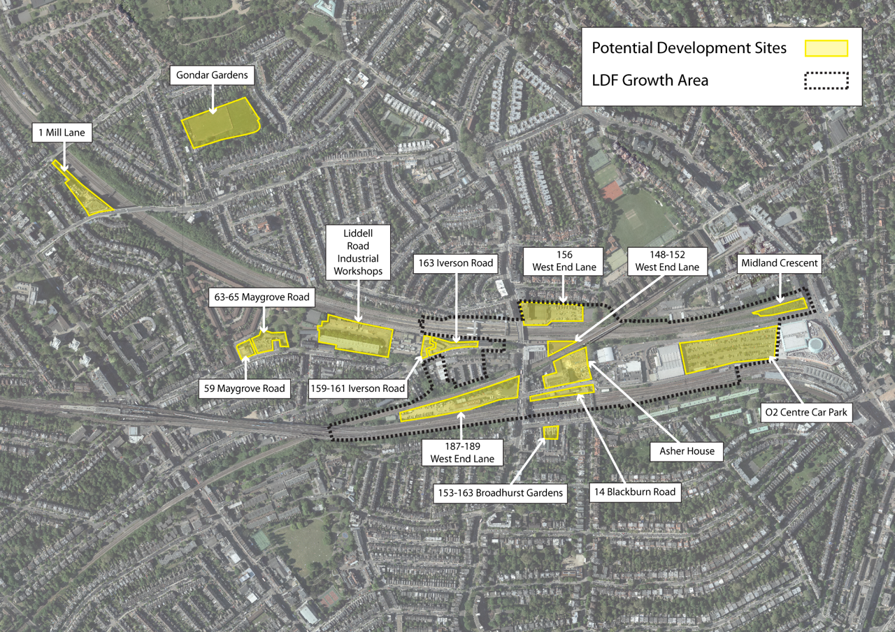
West Hampstead Growth Area map

Slide 11
Camden Council
Our local authority
Duty to support and offer technical support to the NDF
Most of our work has been done with Camden planning officers
Camden has a high number of NDFs
We’re the first NDF in Camden to produce a proposed final draft (and only the second in London!)

Slide 12
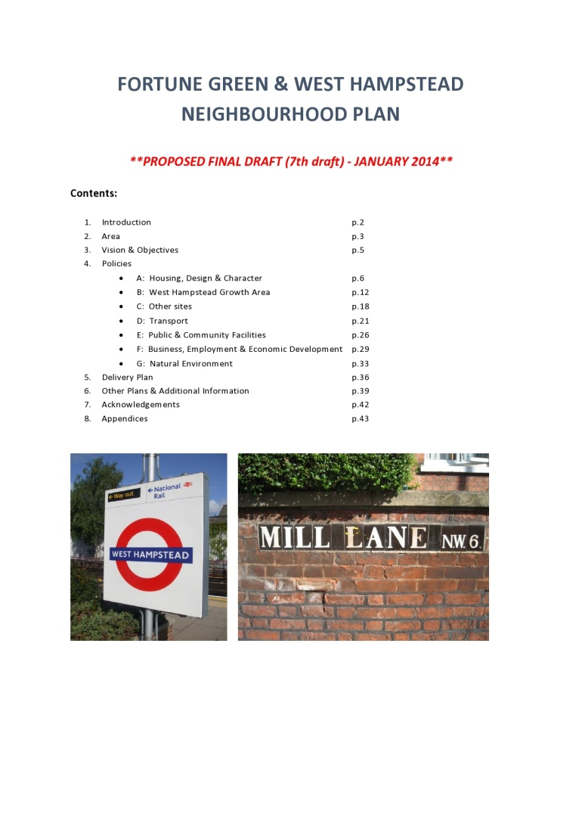
Our Neighbourhood Plan
We worked through a series of drafts – the proposed final draft is the 7th
The Plan has 17 policies – plus recommendations (projects) for action

Slide 13
Policies
Housing
Design & Character
Conservation Areas
Growth Area
Specific Sites
Public Transport
Roads
Cycling
Walking
Community Facilities
11. Business, Commercial & Employment sites
12. West Hampstead Town Centre
13. Mill Lane Neighbourhood Centre
14. Fortune Green Neighbourhood Centre
15. Green Space designation
16. Green/open Space
17. Trees

Slide 14
Additional documents needed
Delivery Plan (see 5.1)
Consultation Statement (draft in February)
Statement of Basic Conditions (Appendix 1)
Sustainability Appraisal (Appendix 2)
Strategic Environmental Assessment (TBC)

Slide 15
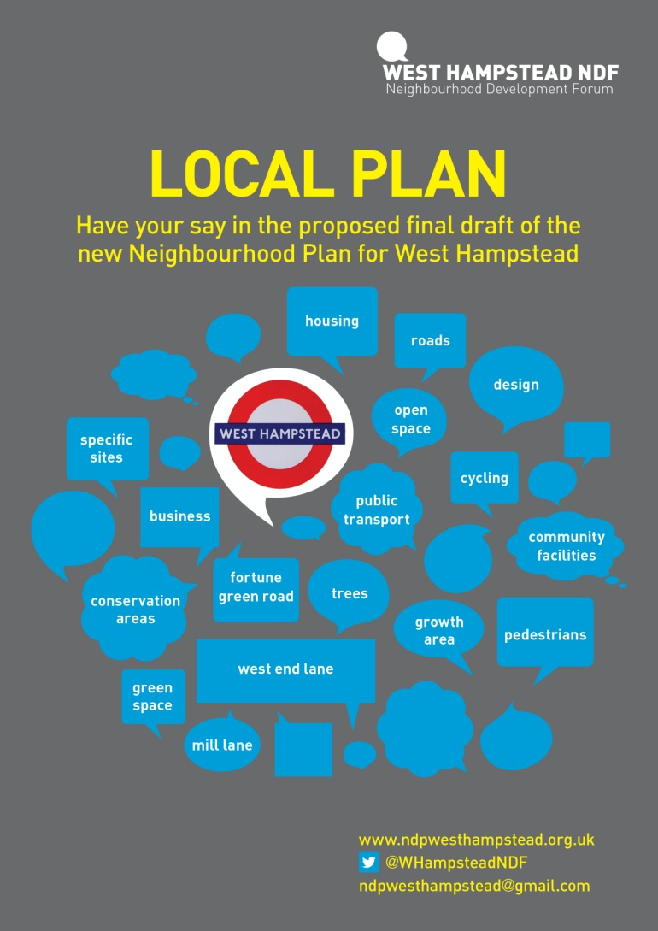
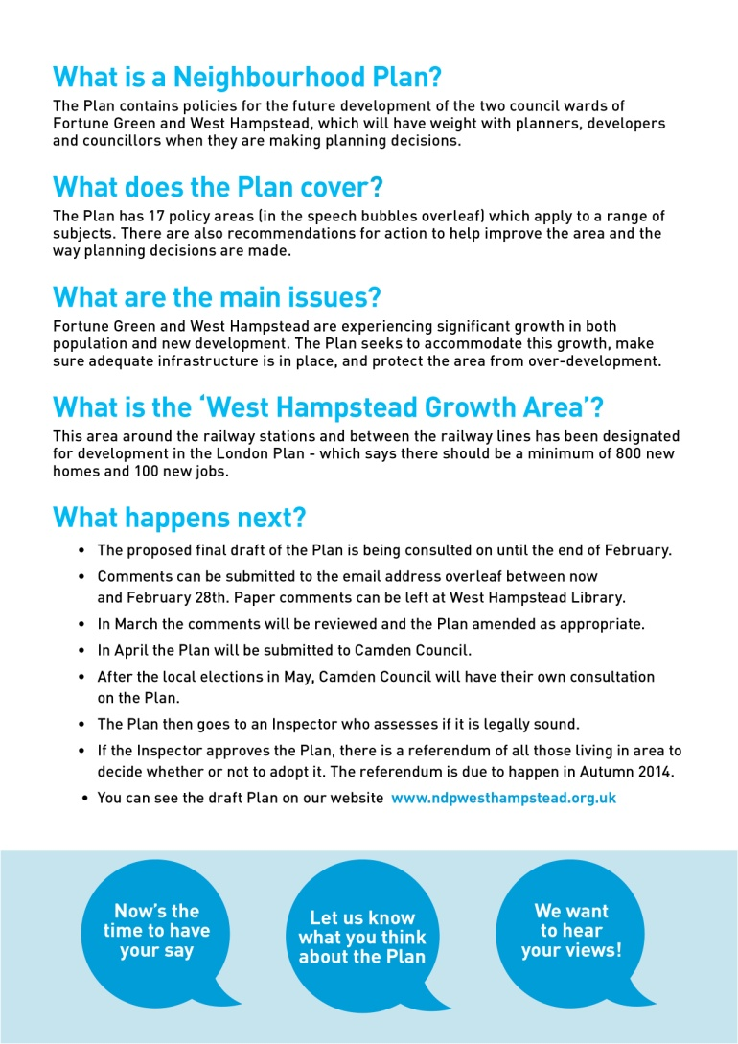
We want your views on the Plan

Slide 16
We also need your help
Spreading the word about the Plan
Submitting your comments – both individuals and groups
Donations to fund the last stage of our work
Volunteers to help with the referendum stage

Slide 17
What happens next?
Deadline for comments: Friday 28th February
March: NDF committee meet to review comments
April: Plan due to be submitted to Camden Council
(May: local elections)
June/July: Camden Council 6 week consultation
Summer: Plan goes to inspector for examination
Autumn: if approved, the Plan will go to a referendum of all those living in the Area

Slide 18
Website: www.ndpwesthampstead.org.uk
Email: ndpwesthampstead@gmail.com
Twitter: @WHampsteadNDF

