Slide 1
Fortune Green & West Hampstead Area Action Group
Tuesday 28 July 2015

Slide 2


The Camden Waste Challenge
28 July 2015
Councillor Meric Apak – Cabinet Member (Sustainability and Environment)
Richard Bradbury – Head of Environment Services

Slide 3

What are we trying to achieve?
Safe and attractive Camden
Green Camden - radical steps to maximise recycling
Clean streets
Better, information, engagement and reporting for residents and businesses
An efficient commercial offer that contributes to a clean borough
Saving money - but reducing spend is not necessarily reducing service

Slide 4



Our Borough in 2013/14
Number of residents
Number of households
Percentage of residents in flats
Total household reuse, recycling and composting collected
Total household waste collected
Total street sweepings collected
230,000 and rising
105,000
85%
21,327 tonnes (1,777 buses)
44,403 tonnes (3,700 buses)
4,486 tonnes (373 buses)
Notes:
(expected to rise by 16800 residents in next 10 years)
A bus is 11m long, if all recycling and waste collected were buses it would go from (64.350km)
An average doubledecker bus weighs 12 tonnes

Slide 5


Your borough wide waste services
Weekly waste collection
Weekly recycling collection
Weekly food and garden waste
‘On request’ white goods and bulky waste collection service
Street cleaning services at least weekly
Business waste and recycling service on request
Seasonal services such as gritting, Christmas trees, leafing
Notes:
What is recyclable? Explain – paper card tin glass etc

Slide 6
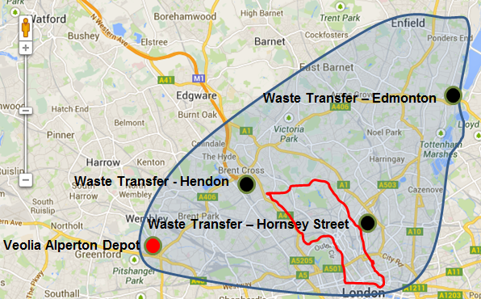
Where does our waste and recycling go?
Bywaters Material Recovery Facility (MRF) – Bromley-by-Bow
Notes:
Composting/Organic goes to Edmonton for compost and after 12 weeks processing for use in agriculture and horticultural use.
Dry recycling goes to Bywater's MRF – 95% of the recyclate from Camden to the MRF is recycled. The rest is incinerated, 0% to landfill.

Slide 7



Costs
Collecting waste and recycling, and cleaning
Disposal of waste
It costs more to dispose of waste than recycling by
If we double the amount we recycle we could save
The amount of waste and associated costs of waste increases annually
£23 million per year
£4.5 million per year
£50 per tonne
£1,000,000

Slide 8
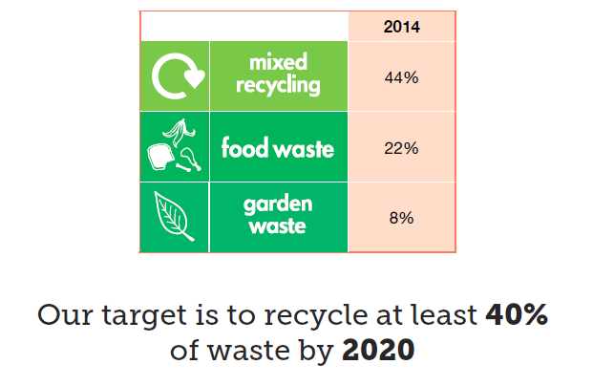
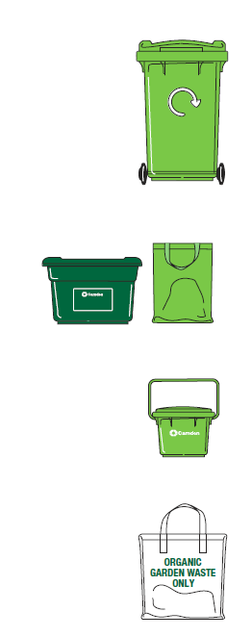
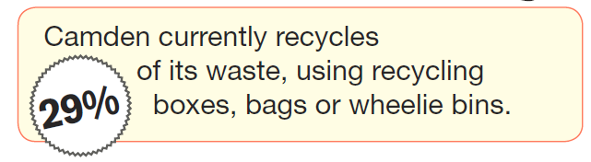
How many people are recycling in Camden?

Slide 9
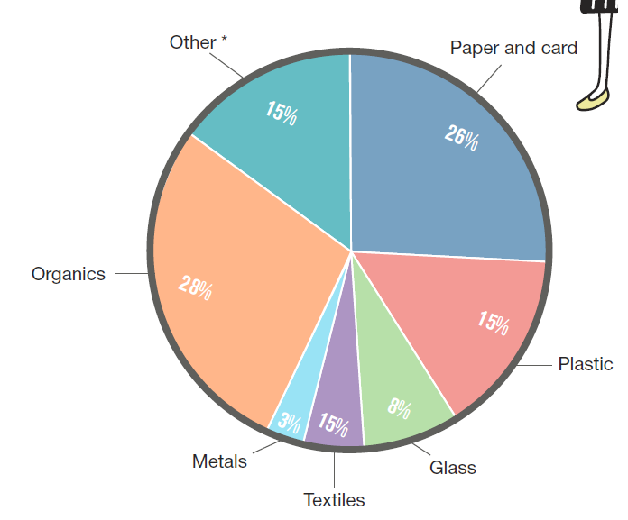

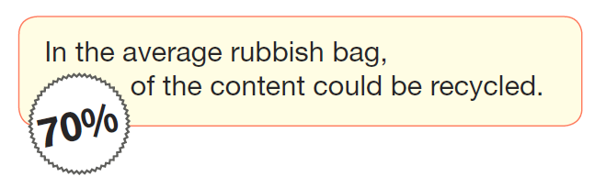


What is still in Camden’s refuse?
Study undertaken by Wastewatch in October 2013

Slide 10




Staff and vehicles (Veolia)
Total – 422 staff and 103 vehicles
Refuse: | - 4 Managers
 | - 104 Operatives
 | - 36 Vehicles
Recycling: | - 3 Managers
 | - 73 Operatives
 | - 30 Vehicles
Streets: | - 8 Managers
 | - 230 Operatives
 | - 37 Vehicles
Notes:
An army of waste and recycling staff to ensure the waste and recycling is collected and that the streets are clean
Just Veolia, not including Camden staff, enforcement, engagement, management etc.

Slide 11
Different Model
Outcomes focussed approach:
Managing Camden’s local environment cleanliness to an agreed standard;
Maximum recycling and also minimising waste and driving up reuse;
Improving business recycling and waste services;
Increased local employment opportunities and local economic development.
Increased use of technology to improve customer experience and operational efficiency
Improved and quicker reporting - ‘Fix My Street’ model
Increased community action - incentivise behaviour change / rewards
New service models - shared services / in-house
20% budget reduction NOT 20% service reduction

Slide 12
Tools for delivery: what works?
More enforcement on street cleansing (proving effective to date)
Wheelie bins for refuse and no extra side waste
Reduced frequency of collection where appropriate (~20% of total households)
Charged-for garden waste service
Incentivisation – trial project being developed now
Big push on estates to increase participation, reduce contamination but also to reduce frequency
Street cleansing change from full sweeps to litter picking, less regular sweeping, and some mechanisation (trials)
Collection from edge of property
Lobbying to reduce waste (and maybe more)
Notes:
All of this is difficult

Slide 13
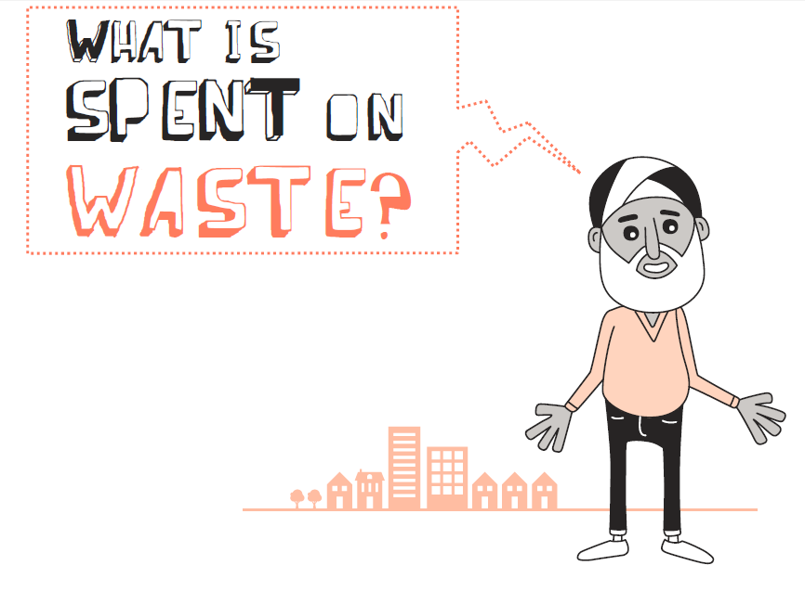
Thank you
Email: camdenwastechallenge@camden.gov.uk
Notes:
Behind this is an engagement campaign which so there are more opportunities to feedback thoughts

Slide 14


Camden’s future libraries –
Formal consultation.
Area Action Group – July 28th 2015

Slide 15
What are we trying to achieve?
Aim to keep as many libraries open as possible, but recognise that tough choices have to be made and unless libraries change we can’t achieve this.
Better meet Camden Plan outcomes through our investment choices for Camden’s public libraries, and achieve £800k savings over 2 years
Recognise the fact that how people use libraries is changing, and we need to change with them to continue to be relevant for future generations
Prioritise investment according to need and impact to retain libraries and library services where they add most value.
Work with a range of partners such Job Centre Plus, Adult and community, public health to ensure libraries grow as vibrant local community “hubs”

Slide 16
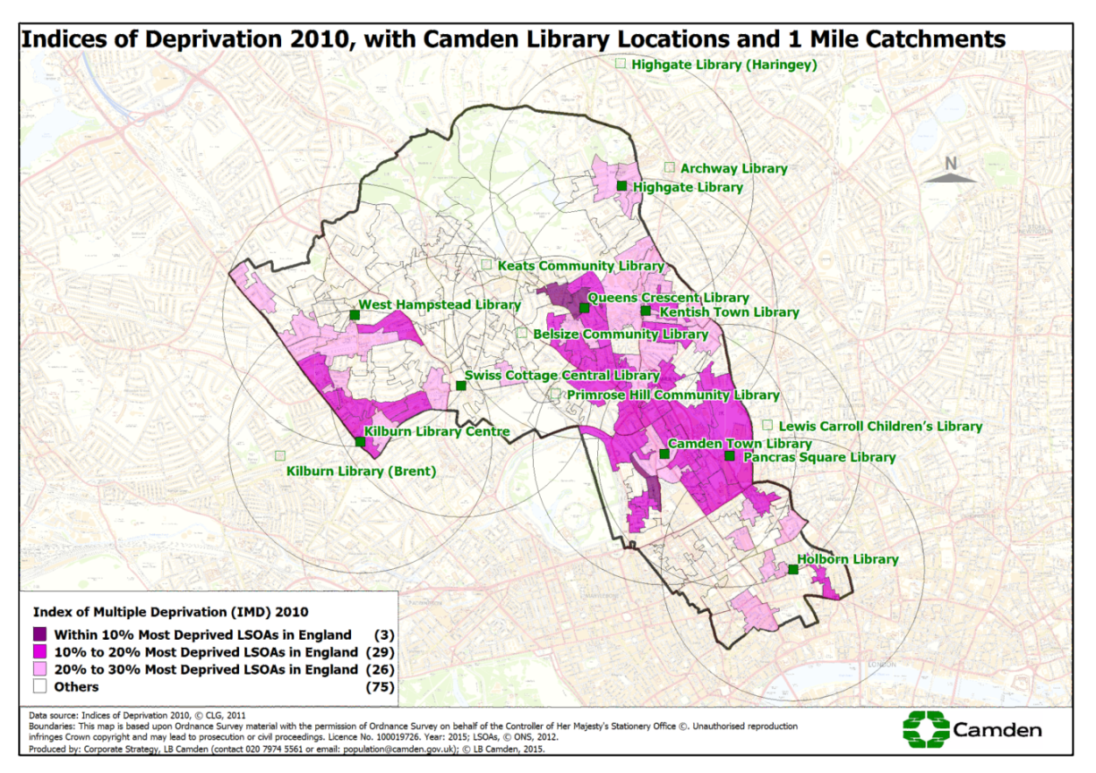
What is our coverage?
99.2% of residents within a mile catchment of a Camden library.
Notes:
Central areas have best access although many of Camden’s most deprived lower super output areas are here.
Good access to a public library for those living near the Camden border - Islington Brent,Haringey

Slide 17
Current performance and take up
3rd highest visits per 1000 population in London (1.8m)
8th highest no. of staff per 1000 pop in London
5th highest book stock per 1000, but only 28th highest no of issues
Take up of library use is good across a range of ages and demographic measures
However underrepresentation of BME groups (27% rather than 33% borough pop.)
Notes:
however masks local variations eg Kilburn Library catchment area 12% of residents identify as black British, the corresponding membership category is 20%.

Slide 18
Camden Libraries – Performance
Ranking | Library | No. of items issued | % of issues
1 | Swiss Cottage | 117,135 | 27.9%
2 | Kentish Town | 57,317 | 13.7%
3 | Pancras Square | 45,703 | 10.9%
4 | Kilburn | 40,835 | 9.7%
5 | Holborn | 40,631 | 9.7%
6 | Camden Town | 37,098 | 8.8%
7 | West Hampstead | 35,230 | 8.4%
8 | Queens Crescent | 26,897 | 6.4%
9 | Highgate | 18,989 | 4.5%
 | Total issues | 419,835 | 100.0%
Ranking of Camden’s libraries based on total issues across the service shows that Swiss Cottage is by far the most used library.
However when ranking is based on cost per visit, and cost per item issue. Larger libraries such as Swiss Cottage and Holborn are amongst the most expensive
Ranking | Library | Cost per issue
1 | Camden Town | £5.63
2 | Kentish Town | £6.06
3 | Highgate | £6.75
4 | St Pancras | £6.82
5 | West Hampstead | £8.04
6 | Kilburn | £10.28
7 | Swiss Cottage | £10.73
8 | Queen's Crescent | £10.93
9 | Holborn | £17.71
Ranking | Library | Cost per visit
1 | Pancras Square | £1.33
1 = | Camden Town | £1.33
3 | Kentish Town | £1.58
4 | Kilburn | £1.66
5 | Highgate | £1.79
6 | Queen's Crescent | £1.89
7 | Swiss Cottage | £3.05
8 | Holborn | £3.18
9 | West Hampstead | £3.28

Slide 19

What do we do in libraries?
Activities for children and young people
‘Baby Bounce’ and ‘Rhyme times’ for under 5’s
Crafts and arts activities for under 5’s
Home work and maths development clubs aimed at 5-12 yr olds
Health Activities for customers
Weight Loss blood pressure and NHS checks
Books on prescription service
Tai Chi, Zumba and Yoga
Smoking cessation
Reader development and creative activities
Reading groups, arts and crafts
Poetry, music, art exhibitions, knitting and crochet and dance events
Advice and learning sessions:
IT classes for over 60’s
‘Tame your device’ advice
Benefits advice
Job Zones and CV writing
Housing options and DHO Homeswap.
Cllr. Surgeries
External partnership delivery
Of the activities listed the following activities are delivered by external partners:
IT support and IT classes for over 60’s
Knitting and crochet
A range of crafts and activities
Art gallery exhibitions
Homework and maths clubs
Benefits advice
Improving English
Smoking Cessation
NHS checks

Slide 20
What we are consulting on?
Our current offer:
In section one of the survey asks for information on people's use of Camden Libraries – ‘what you like to use libraries for, what stops you using libraries and what you think we should be doing more of’.
How savings could be made:
In section two - in this section we ask for views about the different ways in which the savings might be made based on how people think we might prioritise the way we spend our money on Library services.
About our customers:
In section three we ask for more information about respondents so that we can ensure we have a wide range of responses across the whole community.

Slide 21
What we are consulting on?
  The consultation questionnaire talks about the savings that need to be made and our desire to keep all libraries open. However, given the levels of savings which need to be achieved we also have to consider whether to close libraries.
  We ask about what factors the council should consider in setting priorities for investment in reduced opening hours across our libraries or in the event of closure.
In keeping a library open or which libraries we reduce opening hours we ask people to select the top threes of the following factors to determine this :
  in an area with high levels of deprivation
  an area where there are no other libraries nearby
  open a library that receives most visits
  High use PCs or Wi-Fi
  that provides more services than others
  that provides best value for money (how much the library costs to run compared with how many people visit)
  high potential to create income from things like hall hire/ café franchises/ renting space

Slide 22
What we are consulting on?
The consultation asks for views on how people might choose to save £800k and a ‘menu’ of savings options are given. This is divided into the following themes:
Reducing the number of Library branches – For example
Modernising the way the library service is managed or run
Saving | £amount | Tick ✓
Close Swiss Cottage library to save around £500k | £500,000
Close Holborn or Pancras Square Library to save around £300k | £300,000
Close Kentish Town Library or Kilburn Library to save around £200k | £200,000
Close West Hampstead, Queens Crescent, or Camden Town to save around £150k | £150,000
Close Highgate library to save around £30k | £30,000
Saving | £amount | Tick ✓
Reduction in Library managers | £60,000
Outsource service (contract out the running of the service to an external organisation, could be a charitable trust, or an independent provident society) likely to generate some savings on running costs. | £200,000
Holborn and Camden Town Libraries refurbished as part of buildings developments, but may reduce in size. | £100,000
Reduce stock fund for new books to reflect smarter buying choices | £150,000

Slide 23
What we are consulting on?
Use of volunteers/ partnerships with community group
Change in opening hours
Saving | £amount | Tick ✓
Home Library service to be staffed wholly or partly by volunteers | £80,000
Self Service model - keep library opening hours but significantly reduce library staff (remove enquiry desk and increase self-service with less staff support for activities). Aim to bring in volunteers and other organisations to deliver complementary services from library spaces. | £500,000
Saving | £amount | Tick ✓
Reduce all opening hours by 10% to save staff and other costs (excluding Highgate library as already part time and heavily supported by volunteers) | £200,000
Reduce all opening hours by 15% to save staff and other costs (excluding Highgate library as already part time and heavily supported by volunteers) | £300,000
Reduce all opening hours by 25% to save staff and other costs (excluding Highgate library as already part time and heavily supported by volunteers) | £500,000

Slide 24
Opportunities and Options – West Hampstead
The consultation will help determine how we shape our library strategy for the future. Depending on responses ways of making the savings could be:
A change in opening hours
Greater self-service
Use of volunteers to support delivery of service
Review of the space occupied by the library, and whether this can be shared with another group/ organisation
A reduction in building costs, through sharing space with another organisation or looking to provide the library service elsewhere in West Hampstead.

Slide 25
Camden’s future Libraries consultation timelines–
Date | Action | Forum | Outcome / aim
July - Oct 2015 | Launch formal consultation | Libraries, paper and online, targeted outreach | Obtain residents views of changes to library services Meet statutory duties for consultation Engage in conversation with the community, and local groups
Oct 2015 | Analysis and review | Consultation closed | To collate responses Assess cumulative impacts Cost and assess ways forward that take into account consultation responses
Oct/ Nov 2015 | Cost and evaluate possible options | Analyse responses | Cost and assess ways forward that take into account consultation responses Engage third parties in conversations (for example community groups, possible stakeholders), if appropriate.
Nov 2015 | Preparing draft new library strategy | Analyse responses | Discuss and agree strategy
Dec 2015 | Preparing draft new library strategy | Cabinet decision | Discuss and agree strategy Plan implantation, including actions to take place from April 1 2016

Slide 26
Questions?

Slide 27
Fortune Green & West Hampstead Area Action Group
Any other business

